Slide 1
Thesis Defense
Exploring Latent Patterns in U-Turn Crashes: A Dual-Model Approach Using Association Rules Mining and Cluster Correspondence Analysis
Presented by
Syed Aaqib Javed, B.S
June 24, 2025
Notes:
Good morning, everyone. My name is Syed Aaqib Javed. Today I am here to present my master’s thesis, titled ‘Exploring Latent Patterns in U-Turn Crashes: A Dual-Model Approach Using Association Rules Mining and Cluster Correspondence Analysis.
This work was conducted at the AIT Lab in Texas State University, under the supervision of my advisor, Dr. Subasish Das.

Slide 2



Acknowledgement
Committee Chair
Dr. Subasish Das
Assistant Professor,
Texas State University
Committee Members
Dr. Jung Yeon
Assistant Professor,
Texas State University
Dr. Feng Hong
Associate Professor of Practice,
Texas State University
Notes:
I want to sincerely thank my advisor, Dr. Das, for his support and guidance. I also thank my committee members, Dr. Jung Yeon and Dr. Feng Hong, for their helpful feedback throughout this process.

Slide 3




Outline
Background
Methodology
Literature Review
Research Gap and Research Questions
Data Description
Study Design
Conclusion
Results and Discussion
Notes:
Here is a brief overview of what I’ll be covering today.
I’ll start with some background on the topic and a review of existing literature. Then, I’ll discuss the research gaps, followed by an overview of methodology. I’ll also discuss the data used, the study design, and key findings. Finally, I’ll conclude with a summary of contributions, limitations, and directions for future research.

Slide 4
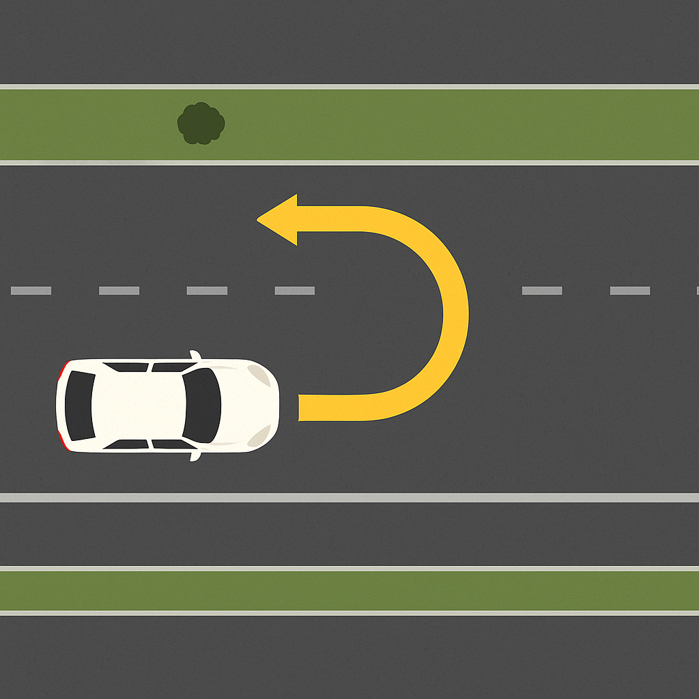
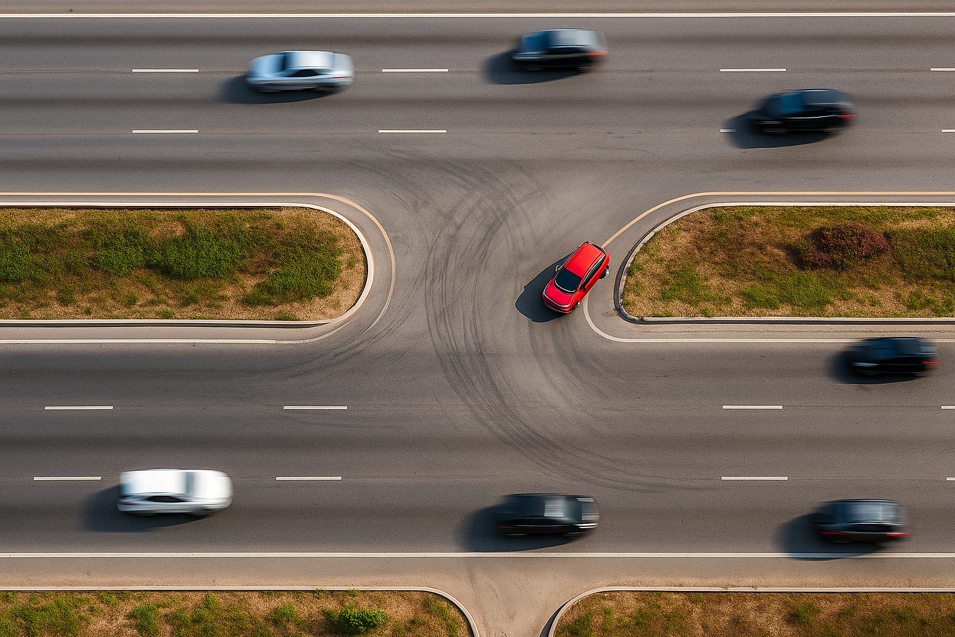
What is U-turn
A U-turn is a driving maneuver that allows a vehicle to reverse direction by turning in a U shape.
It’s often used when a driver misses a turn or needs to reroute quickly.
Notes:
First we need to understand what is U-turn? A U-turn is a traffic maneuver in which a driver makes a 180-degree turn to reverse the direction of travel on a roadway.

Slide 5
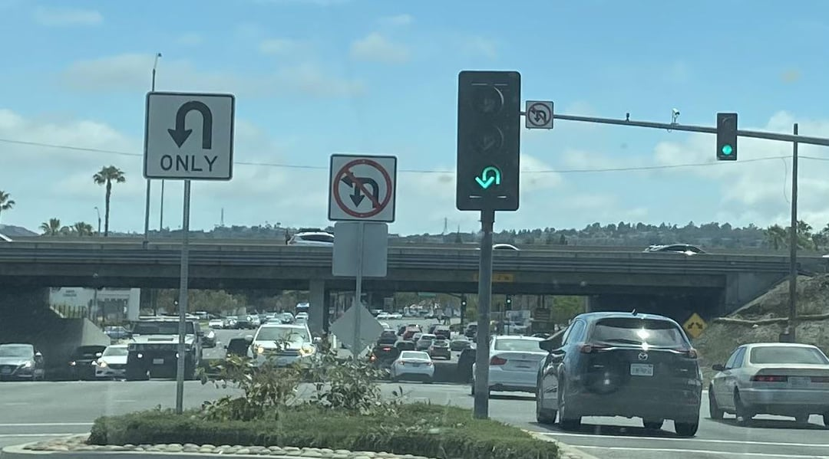

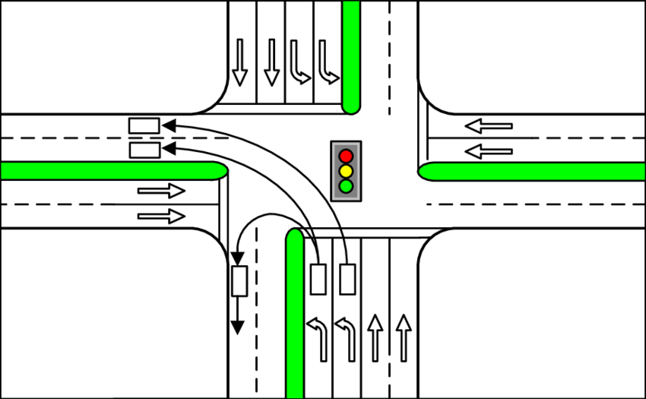
Types of U-turn
01
Signalized U-Turn
Controlled by a traffic light.
Often integrated into protected left-turn phases.
Improves traffic flow predictability.
Reduces the likelihood of angle and side-swipe crashes.
Notes:
There are many types of U-turn. First signalized U-turn. In this type there is a dedicated traffic light for U-turn. It improves traffic flow and helps reduce angle and side-swipe crashes

Slide 6



Types of U-turn
Diverging 6 Merging 6
Crossing 2
CONFLICTS 14
02
03
Median U-Turn
Diverging 6 Merging 6
Crossing 4
Restricted Crossing U-Turn
CONFLICTS 16
Notes:
Now Median U-turn. In this setup, left turns from the side road are not allowed directly. Instead, vehicles turn right and then make a U-turn at a designated median opening. In this design there are 6 diverging, 6 merging, and 4 crossing conflict point. In total there are 16 conflict points.
Now Restricted Crossing U-turn. In this design, side street traffic cannot go straight or turn left directly. Instead, drivers must turn right and then make a U-turn at the designated median. In this design there are 6 diverging, 6 merging, and 2 crossing conflict points. In total there are 14 conflict points.

Slide 7


Types of U-turn
Lower
Level
Diverging 6 Merging 8
Crossing 10
CONFLICTS 24
04
05
Diverging Diamond Interchange
Diverging 8 Merging 8
Crossing 2
Jughandle
CONFLICTS 18
Notes:
Next type is the Diverging Diamond Interchange. This design briefly shifts traffic to the left side to make left turns and U-turns easier without crossing oncoming traffic. There are 8 diverging, 8 merging, and 2 crossing conflict points. In total there are 18 conflict points.
Next type is Jughandle. Instead of turning left directly from main road, drivers exit right before the intersection, loop around, and then cross the main road. In this design there are 6 diverging, 8 merging, and 10 crossing conflict points. In total there are 24 conflict points.

Slide 8


Types of U-turn
Diverging 8 Merging 8
Crossing 4
CONFLICTS 20
06
07
Thru-Cut
Diverging 6 Merging 6
Crossing 8
Bowtie
CONFLICTS 20
Notes:
Next type is the Thru-Cut. Vehicles from the side roads can’t go straight directly. They need to turn left or right and make a u-turn. There are 6 diverging, 6 merging, and 8 crossing conflict points. In total there are 20 conflict points.
This one is called Bowtie Design. Instead of making left turns at the main intersection, vehicles use nearby roundabouts on both sides. There are in total 20 conflict points.

Slide 9


Types of U-turn
Diverging 8 Merging 8
Crossing 12
CONFLICTS 28
08
09
Teardrop
Diverging 6 Merging 6
Crossing 4
Displaced Left-Turn
CONFLICTS 16
Notes:
The Teradrop design is similar to the bowtie but uses connected roundabouts that look like teardrops. This setup creates 16 total conflict points including 6 diverging, 6 merging, and 4 crossing conflict points.
This design is called a Displaced Left-Turn. In this type, left-turning vehicles cross over to the other side of the road before reaching the main intersection. This type have total 28 conflict points, including 8 diverging, 8 merging, and 12 crossing conflict points.

Slide 10


Types of U-turn
Diverging 3 Merging 3
Crossing 3
CONFLICTS 9
10
11
Quadrant Roadway
Diverging 10 Merging 10
Crossing 10
Continuous Green-T
CONFLICTS 30
Notes:
This one is called the Quadrant Roadway. It adds an extra road through one corner of the intersection, allowing left-turning vehicles from major roadway to bypass the main intersection. In this design there are 10 diverging, 10 merging, and 10 crossing conflict points. In total there are 30 conflict points.
This design is known as Continuous Green-T. The traffic on the one side of the main road keeps a constant green while side-street traffic uses separate lanes for left turns and U-turns. It has a total of 9 conflict points, with 3 each for diverging, merging, and crossing.

Slide 11
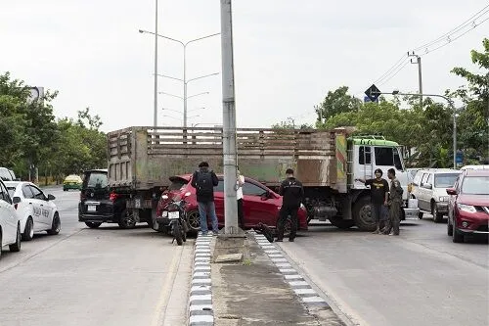
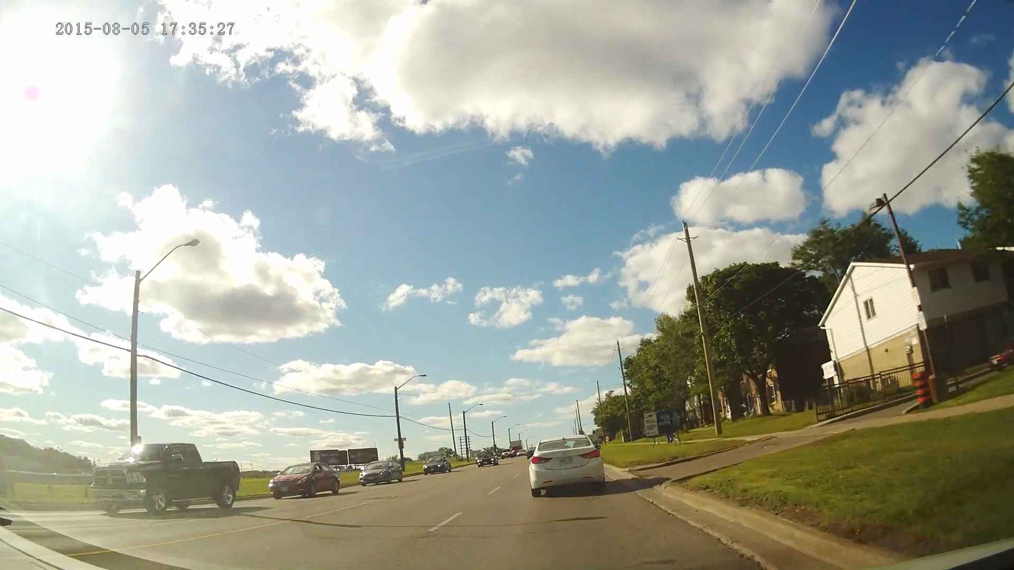
Why is U-turn crash analysis important?
Notes:
Why is u-turn crash analysis important? I think this image and video can clearly show why U-turn crash analysis is so important. U-turns involve complex interactions with other vehicles, and mistakes can easily lead to serious crashes, as we see here.

Slide 12

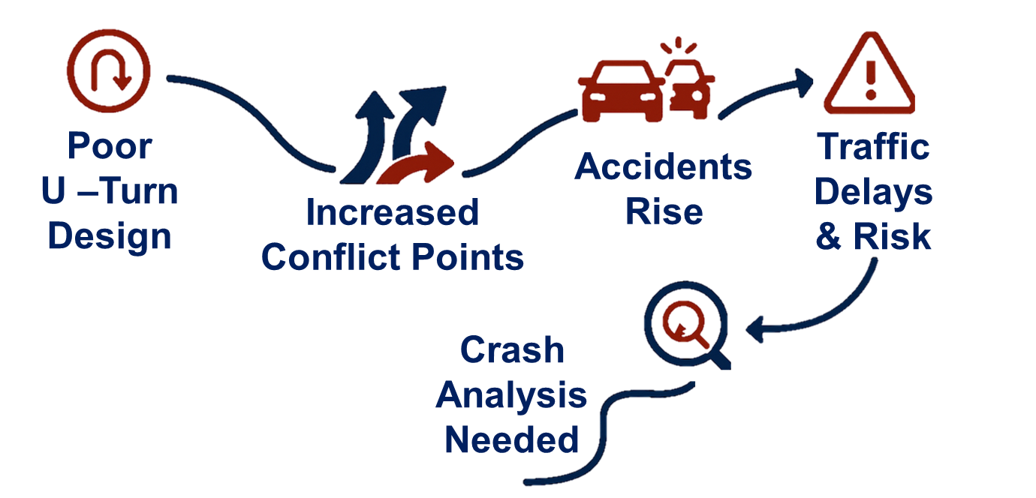

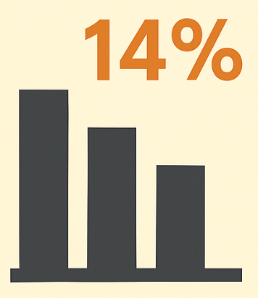

Why is U-turn crash analysis important?
U-turns are complex maneuvers involving gap judgment and merging under challenging conditions like high speed or low visibility.
Alternative intersections (MUT, RCUT, DDI) improve flow but shift crash risk to U-turn zones with limited space and signage.
U-turns have crash rates of 0.41/year (urban) and 0.20 (rural) and are a factor in 14% of all crashes (FHWA, NHTSA).
U-turns are often grouped with left-turns in studies, masking their unique risks and creating a gap in safety research.
Notes:
1. U-turns are complex driving maneuvers that require drivers to decelerate, judge gaps, and merge under pressure—often in high-speed, or low-visibility conditions.
2. Many alternative intersections like RCUTs or DDIs improve traffic flow overall—but they shift more turning maneuvers to U-turn zones, which often have limited signage and maneuvering space.
3. According to FHWA (2023), U-turns at unsignalized median openings have a crash rate of 0.41 in urban areas and 0.20 in rural areas and are a pre-crash factor in 14% of roadway crashes.
4. U-turn crashes are frequently grouped with left-turns in studies, masking their unique behavior and creating a serious gap in targeted safety research.

Slide 13


Literature Review
🛣️
Schroeder et al. (2024) and Sun et al. (2019a) found that wider medians, acceleration lanes, and optimal turn radii improve U-turn safety by reducing conflicts and aiding vehicle maneuverability.
Mishra and Pulugurtha (2022) and Edara (2024) showed that RCUTs, MUTs, and J-turns reduce crash rates, but shift complexity to U-turn maneuvers, requiring careful design.
Ulak et al. (2020) and Zubair and Shaikh (2015) highlighted that poor gap acceptance and aggressive driving, especially in poorly designed or enforced environments, contribute to U-turn crashes.
Notes:
Schroeder and Sun found that wider medians, acceleration lanes, and optimal turn radii improve U-turn safety by reducing conflicts.
Mishra and Pulugurtha (2022) and Edara (2024) showed that RCUTs, MUTs, and J-turns reduce crash rates, but shift complexity to U-turn maneuvers.
Ulak et al. (2020) and Zubair and Shaikh (2015) highlighted that poor gap acceptance and aggressive driving, especially in poorly designed environments, contribute to U-turn crashes.

Slide 14



Literature Review
Abdel-Aty et al. (2020), Mullani et al. (2022), and Molan et al. (2022) demonstrated the value of IoT alerts, adaptive signals, and machine learning in predicting and preventing U-turn-related risks.
Kay et al. (2022), El-Urfali (2019), and Edara et al. (2013) emphasized combining CMFs, SPFs, and public input to guide intersection design and system-wide safety improvements.
Shafie and Rahman (2016) and Shahdah and Azam (2021) found that U-turn crash risks stem from the interplay of geometry, driver behavior, and environmental conditions—underscoring the need for holistic analysis.
Notes:
Abdel-Aty et al. (2020), Mullani et al. (2022), and Molan et al. (2022) demonstrated the value of IoT alerts, adaptive signals in predicting and preventing U-turn-related risks.
Kay et al. (2022), El-Urfali (2019), and Edara et al. (2013) emphasized combining CMFs, and SPFs to guide intersection design and system-wide safety improvements.
Shafie and Rahman (2016) and Shahdah and Azam (2021) found that U-turn crash risks stem from the interplay of geometry, driver behavior, and environmental conditions—underscoring the need for holistic analysis.

Slide 15

Research Gap
Grouped With
Left Turn
Overlook Design Factors
Impact of RCUTs/MUTs
Limited
Models
Most studies group U-turns with left-turns, overlooking their distinct operational demands and safety challenges.
Studies focus mostly on geometric design, overlooking behavioral, environmental, and contextual crash factors.
The impact of RCUTs and MUTs on U-turn safety and crash severity is still underexplored.
Traditional models miss complex, nonlinear crash patterns, highlighting the need for more advanced, data-driven methods.
Notes:
There are some gaps in current U-turn crash research.
Most studies group U-turns with left-turns, overlooking their distinct operational demands and safety challenges.
Existing research largely emphasizes geometric parameters, with limited integration of behavioral, environmental, and contextual factors that influence U-turn crash risk.
While RCUTs and MUTs are known to reduce overall crash frequencies, their downstream impact on U-turn performance and crash severity remains insufficiently explored.
Traditional statistical models dominate current analyses, lacking the ability to capture complex, nonlinear, and interdependent crash patterns, highlighting the need for more advanced, data-driven methods.

Slide 16


Research Objective
A+B => C
Association Rule Mining
Cluster Correspondence Analysis
Combined Effects
Apply Association Rule Mining (ARM) with Lift Increase Criterion (LIC) to identify frequent factor combinations linked to U-turn crash severity
Use Cluster Correspondence Analysis (CCA) to group U-turn crashes based on crash attributes and severity relationships.
Analyze how combined factors (e.g., road type, lighting, driver demographics) influence crash outcomes to support targeted safety improvements.
Notes:
The Objective of this study is-
1. To Apply Association Rule Mining (ARM) with Lift Increase Criterion (LIC) to identify frequent factor combinations linked to U-turn crash severity.
2. To implement Cluster Correspondence Analysis (CCA) to classify U-turn crashes into distinct clusters based on relationships between crash attributes and severity outcomes.
3. To develop Analyze how combined factors (e.g., road type, lighting, driver demographics) influence crash outcomes to support targeted safety improvements.

Slide 17
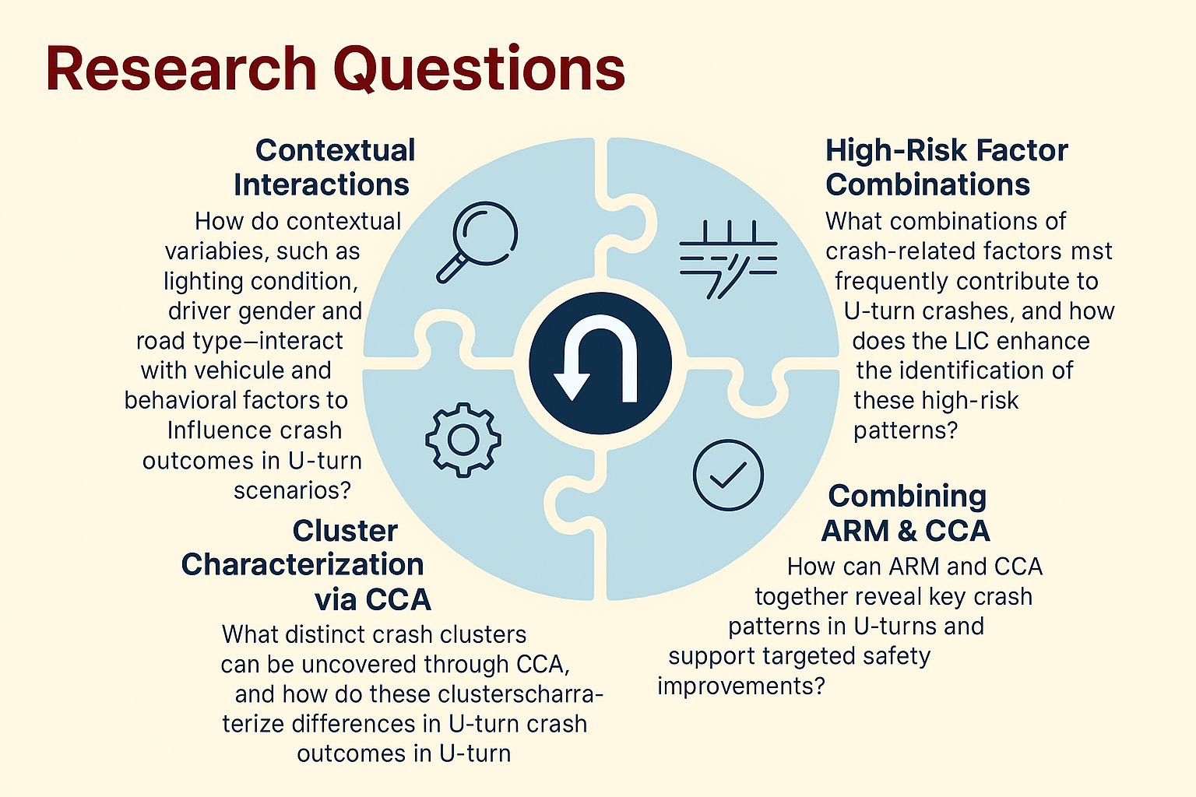



Research Questions
Notes:
So the research question of this study is -
How do contextual variables, such as lighting condition, driver gender—interact with vehicle and behavioral factors to influence crash outcomes in U-turn scenarios?
What combinations of crash-related factors most frequently contribute to U-turn crashes, and how does the LIC enhance the identification of these high-risk patterns?
What distinct crash clusters can be uncovered through CCA, and how do these clusters characterize differences in U-turn crash severity?
How can ARM and CCA together reveal key crash patterns in U-turns and support targeted safety improvements?

Slide 18




Methodology
ARM is an effective data mining method to explore interesting relationships between features from a large dataset.
First proposed by Agrawal et al., 1993, ARM is widely used in pattern discovery.
Key Steps in ARM:
Identify frequent itemsets from the given dataset, and
Generate association rules from the identified frequent itemsets.
Key Parameters: Support – How frequently the itemset appears in the dataset. Confidence – Likelihood that an item Y is present when item X is present.
Lift – Measures the strength of a rule over random co-occurrence.
Notes:
ARM is an effective data mining method which was first proposed by Agrawal to explore interesting relationships between features from a large dataset. It includes two main steps: (1) identify frequent itemsets from the given dataset, and (2) generate association rules from the identified frequent itemsets.
Support, confidence, and lift are three main parameters in ARM to generate and filter strong rules from a dataset.

Slide 19
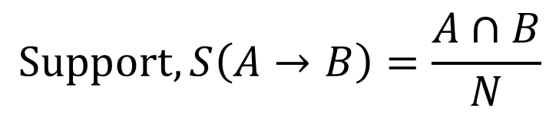
Methodology
Support is defined as the frequency or the number of times an itemset appears in a given transactional database (Agrawal et al., 1993).
For example, if the support of an itemset or item is 0.05%, it indicates that the itemset or item occurs in only 0.05% of the total transactions within the database.
$$Support, S\left(A→B\right)=\frac{A∩B}{N}$$
Notes:
Support is defined as the frequency or the number of itemset appears in a given transactional database.
For example, if the support of an itemset or item is 0.05%, it indicates that the itemset occurs in only 0.05% of the total transactions within the database.

Slide 20
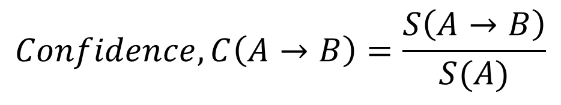
Methodology
Confidence is defined as the conditional probability P(A│B), which represents the likelihood of both A and B occurring together
For instance, if the confidence of a rule is 90%, it indicates that 90% of the transactions containing X also include Y.
$$Confidence, C\left(A→B\right)=\frac{S\left(A→B\right)}{S(A)}$$
Notes:
Confidence is defined as the likelihood of both A and B occurring together. For instance, if the confidence of a rule is 90%, it indicates that 90% of the transactions containing X also include Y.

Slide 21

Methodology
Lift represents the ratio of the confidence of the rule to the expected confidence, assessing how frequently the antecedents and consequences of a rule occur together compared to what would be expected if they were statistically independent.
Lift > 1: antecedent and consequent occur together more than expected (positive correlation).
Lift < 1: they occur together less than expected (negative correlation).
Lift = 1: they occur together as expected (independence).
$$Lift, L\left(A→B\right)=\frac{C\left(A→B\right)}{S\left(B\right)}=\frac{S\left(A→B\right)}{S\left(A\right).S\left(B\right)}$$
Notes:
Lift represents how frequently the antecedents and consequences of a rule occur together compared to what would be expected if they were statistically independent.
Lift > 1: antecedent and consequent occur together more than expected (positive correlation).
Lift < 1: they occur together less than expected (negative correlation).
Lift = 1: they occur together as expected (independence).

Slide 22

Methodology
LIC is used to evaluate multi-item rules in ARM to ensure each additional item contributes meaningful predictive power.
It compares the lift of a base (parent) rule with the lift of an expanded rule that includes one more item.
$$LIC=\frac{{Lp}_{r+1}}{{Lp}_{r}}$$
Notes:
LIC is used to evaluate multi-item rules in ARM to ensure each additional item contributes meaningful predictive power.
It compares the lift of a base (parent) rule with the lift of an expanded rule that includes one more item.

Slide 23

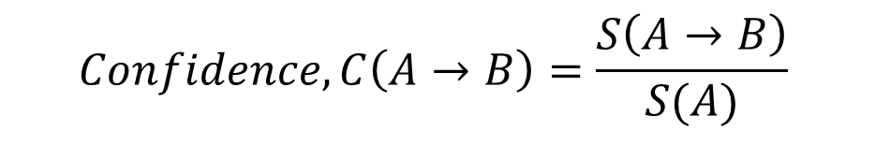
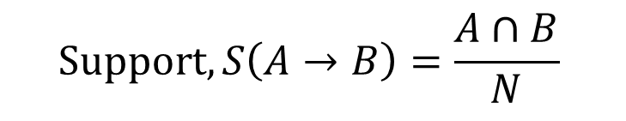
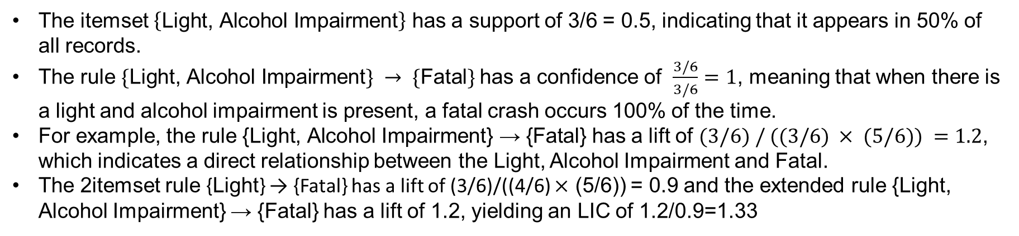
Example of ARM
Crash Id | Light | Speed Limit | Alcohol Impairment | Cloudy Weather | Signalized Intersection | Fatal
1000 | 1 | 1 | 1 | 0 | 1 | 1
1001 | 1 | 0 | 1 | 1 | 0 | 1
1002 | 1 | 1 | 1 | 1 | 1 | 1
1003 | 0 | 1 | 0 | 0 | 0 | 0
1004 | 1 | 0 | 0 | 0 | 1 | 1
1005 | 0 | 0 | 0 | 1 | 1 | 1
The itemset $\left\{\text{Light}\text{, }\text{Alcohol} \text{Impairment}\right\}$ has a support of 3/6 = 0.5, indicating that it appears in 50% of all records.
The rule $\{\text{Light}\text{, }\text{Alcohol} \text{Impairment}\} → \{\text{Fatal}\}$has a confidence of $\frac{3/6}{3/6}=1$, meaning that when there is a light and alcohol impairment is present, a fatal crash occurs 100% of the time.
For example, the rule $\text{\{}\text{Light}\text{, }\text{Alcohol} \text{Impairment}\text{\} → \{}\text{Fatal}\text{\}}$ has a lift of $(3/6) / ((3/6) × (5/6)) =1.2$, which indicates a direct relationship between the Light, Alcohol Impairment and Fatal.
The 2itemset rule {Light} → {Fatal} has a lift of (3/6)/((4/6) $×$ (5/6)) = 0.9 and the extended rule {Light, Alcohol Impairment} → {Fatal} has a lift of 1.2, yielding an LIC of 1.2/0.9=1.33
$$Support, S\left(A→B\right)=\frac{A∩B}{N}$$
$$Confidence, C\left(A→B\right)=\frac{S\left(A→B\right)}{S(A)}$$
$$Lift, L\left(A→B\right)=\frac{C\left(A→B\right)}{S\left(B\right)}=\frac{S\left(A→B\right)}{S\left(A\right).S\left(B\right)}$$
$$LIC=\frac{{Lp}_{r+1}}{{Lp}_{r}}$$
Notes:
I think this example will help us to clearly understand how ARM works. There are 6 crash dataset and 6 variables (light, speed limit, Alcohol impairment, Cloudy weather, Signalized intersection and Fatal). 1 means The variable is present or yes and 0 means the variable is absent or no.
Now if we want to calculate the support value of $\text{Light}\text{, }\text{Alcohol} \text{Impairment}$, the support is simply 3/6 as $\text{Light} \text{and} \text{Alcohol} \text{Impairment}$ both are present in top 3 crash data and there are total 6 crash data. So it becomes 0.5 which means it appears in 50% of all records. Now if we want to calculate the confidence value of $\left\{\text{Light}\text{, }\text{Alcohol} \text{Impairment}\right\}→ \left\{\text{Fatal}\right\}$, it is simply support value of A$→$B which is support value of light alcohol and fatal which is 3/6 as in top 3 crash data this 3 variables are present together and divided by support value of A means support value of light and alcohol and is 0.5 which is calculated earlier. So confidence is 1 meaning that when there is a light and alcohol impairment is present, a fatal crash occurs 100% of the time. Now if we want to calculate the lift value of this rule than we need to divide the confidence value by support value of B which is support of fatal and which is 5/6. so the lift value comes 1.2 which indicates a direct relationship between the Light, Alcohol Impairment and Fatal.
Now if we want to calculate the LIC value of this rule, 1st we need to calculate the lift value in the similar way of the 2itemset rule which is {Light} → {Fatal} and is 0.9. when alcohol is added it becomes the 3itemset rule and the lift value is 1.2 as we calculated earlier. So the LIC is 1.2/0.9=1.33. This means when alcohol is added with light the likelihood of fatality is increased.

Slide 24
Methodology
CCA combines correspondence analysis and k-means clustering to find patterns in categorical crash data by grouping similar crash cases and related factor categories (van de Velden et al., 2017).
It first converts the data into a binary format (super indicator matrix), then finds category positions and cluster groups that best separate the data.
A biplot is created to visualize how crash factors relate to each other across different clusters.
Notes:
CCA combines correspondence analysis and k-means clustering to find patterns in categorical crash data by grouping similar crash cases and related factor categories.
It first converts the data into a binary format, then finds category positions and cluster groups that best separate the data.
A biplot is created to visualize how crash factors relate to each other across different clusters.

Slide 25



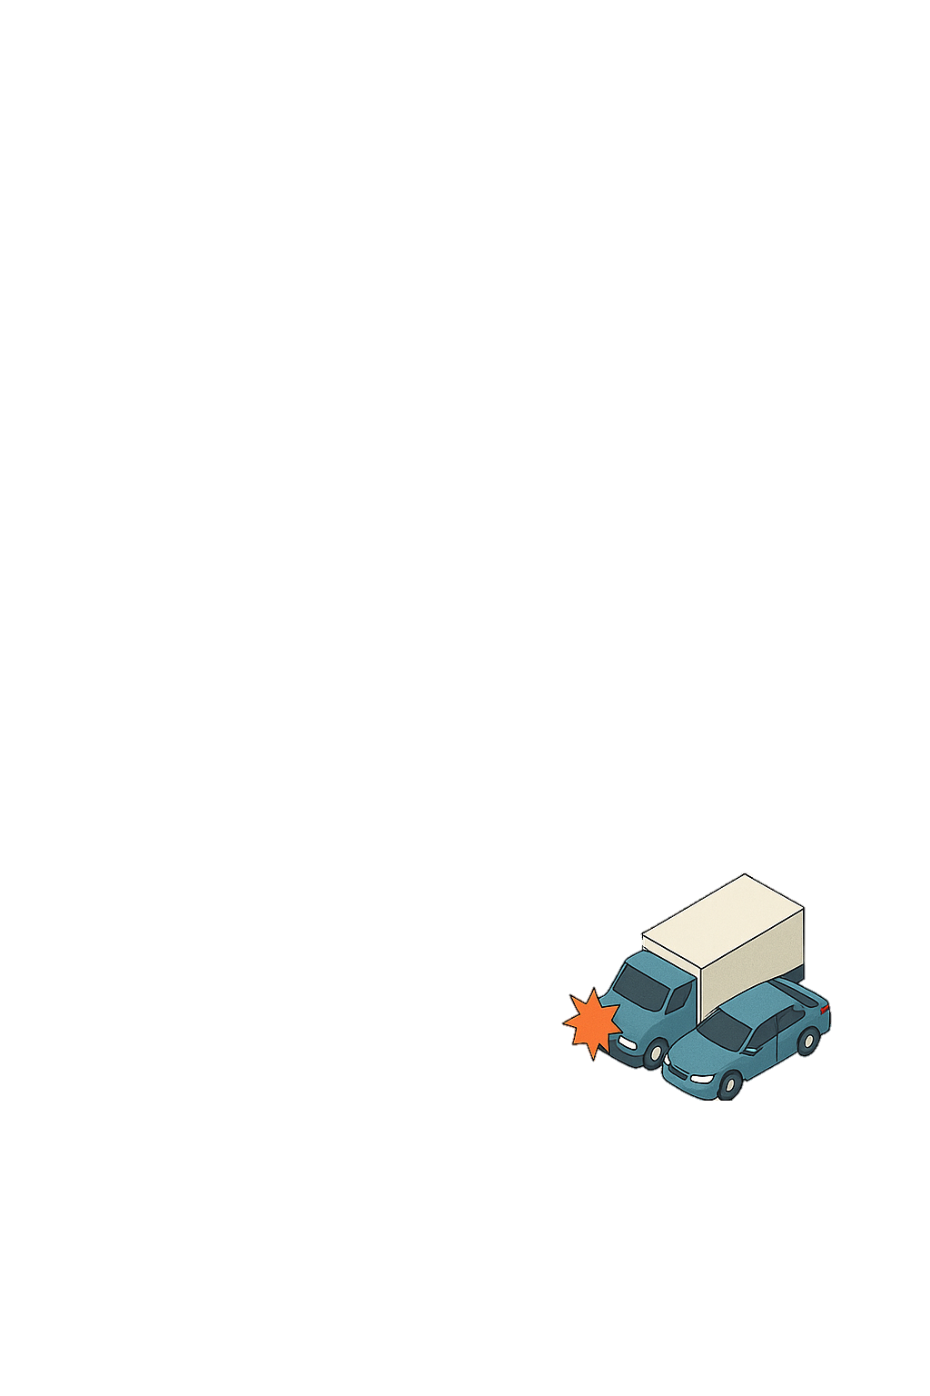

Data Description
This study collected five years (2017–2021) of U-turn crash data from Ohio, covering 2,716 crashes categorized by severity: O (No Injury/Property Damage Only), BC (Moderate/Minor), and KA (Fatal/Severe).
Geometric &
Roadway Factors
Road facility type
Functional class
Number of Through Lanes
Location (e.g., intersection type)
Road Condition
Surface Condition
Posted Speed Limit
Environmental
Conditions
Lighting condition
Weather condition
Vehicle & Crash Characteristics
Vehicle type
Commercial motor vehicle
Number of vehicles
Crash type
Sequence of events
Object struck
Driver &
Behavioral Factors
Driver gender
Driver impairment
Contributing factors
Notes:
This study analyzed 5 years of U-turn crash data from 2017 to 2021 from Ohio which consist of 2,716 crashes, categorized by severity O (No Injury/Property Damage Only), BC (Moderate/Minor), and KA (Fatal/Severe).
Crash data included Geometric & roadway features, environmental conditions, and driver behaviors and Vehicle & Crash Characteristics.

Slide 26
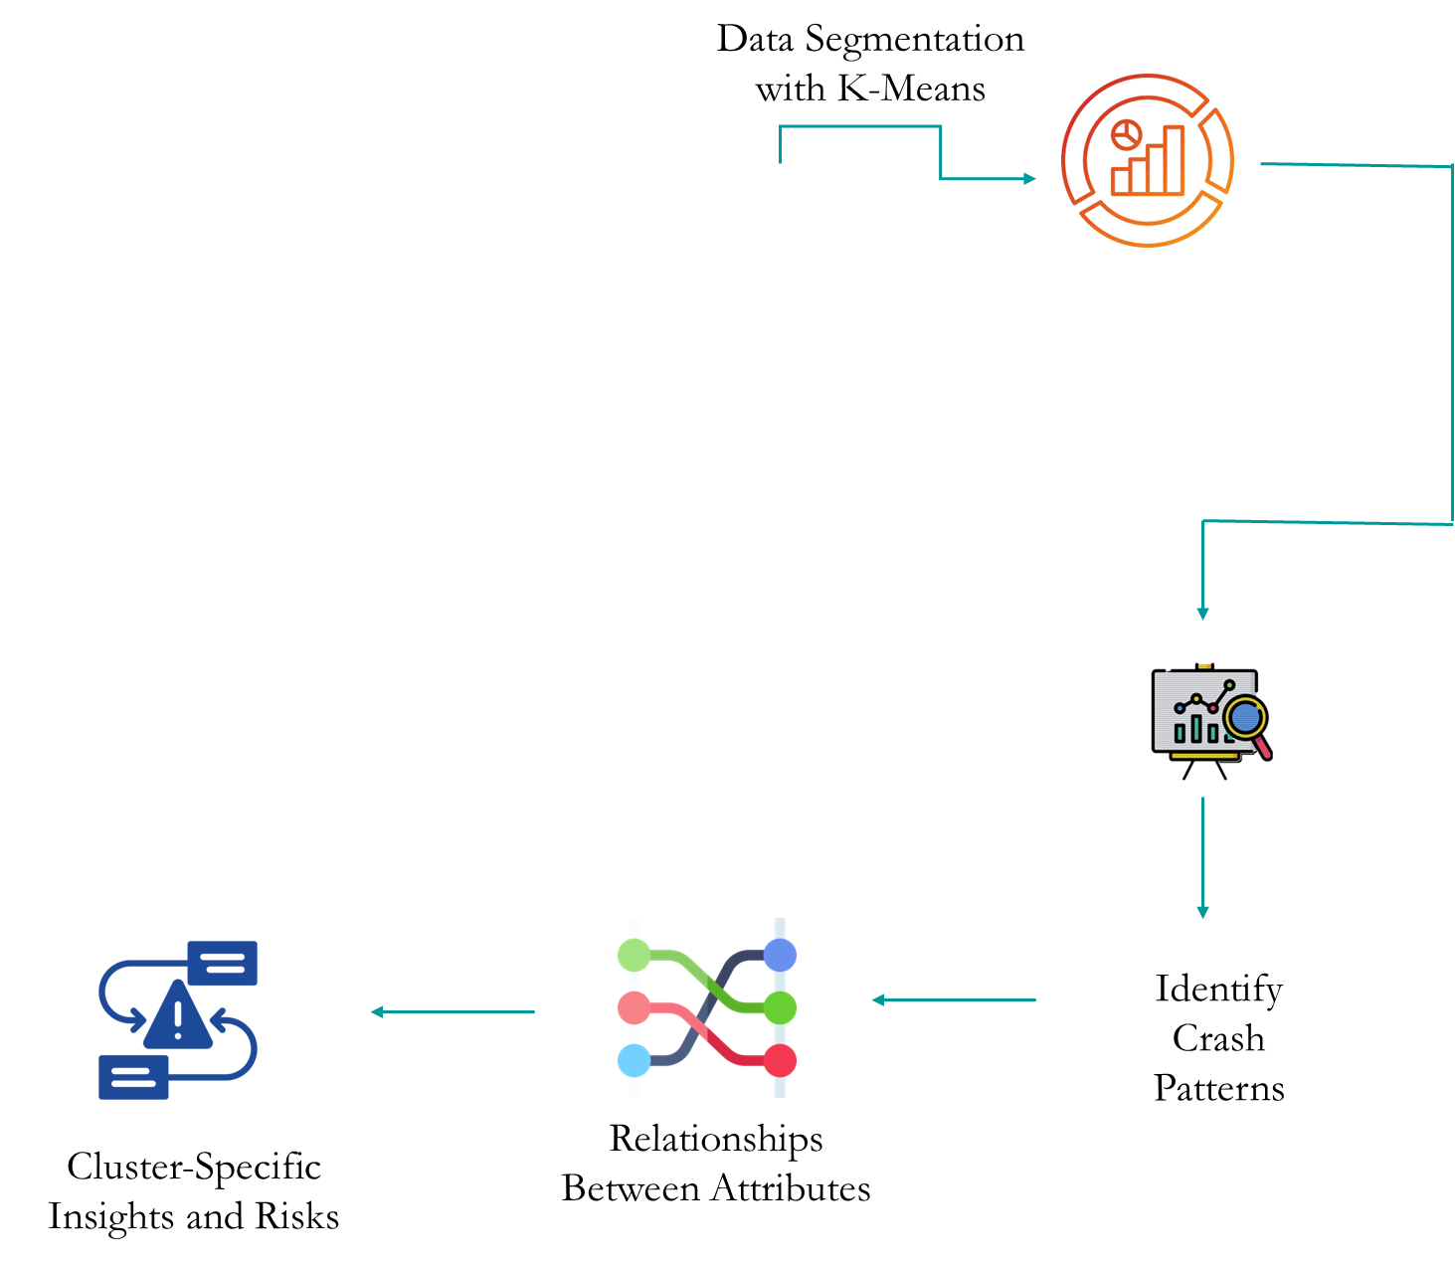
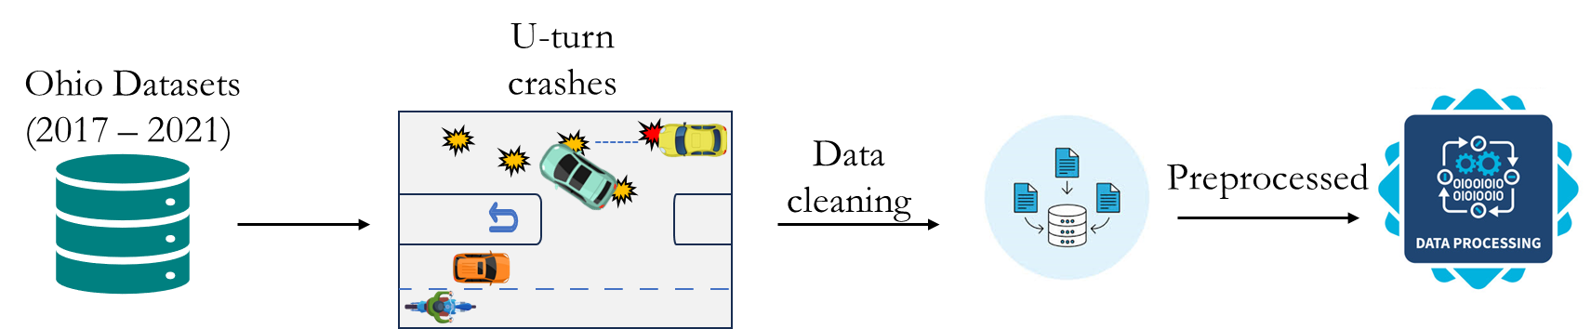
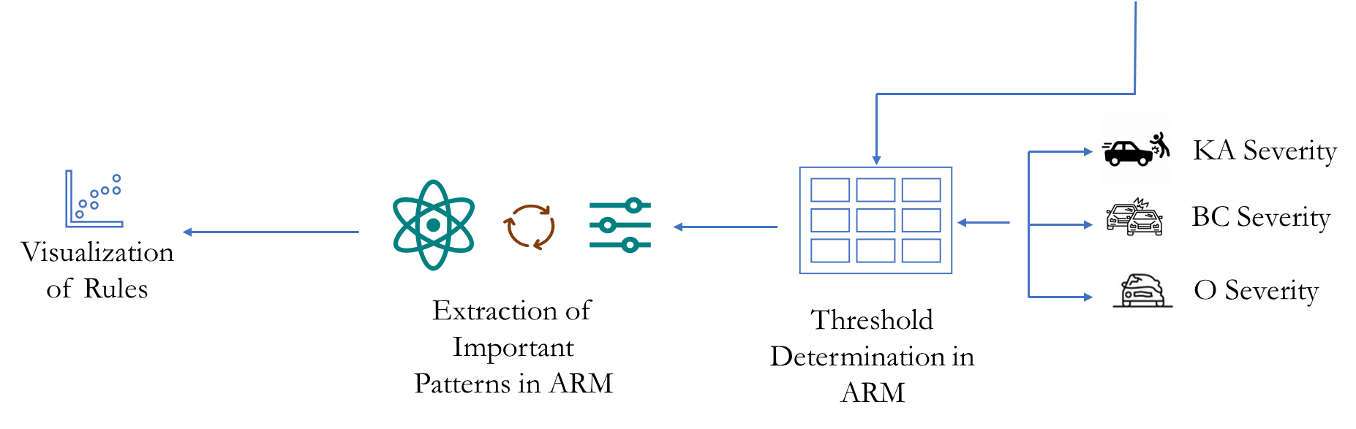
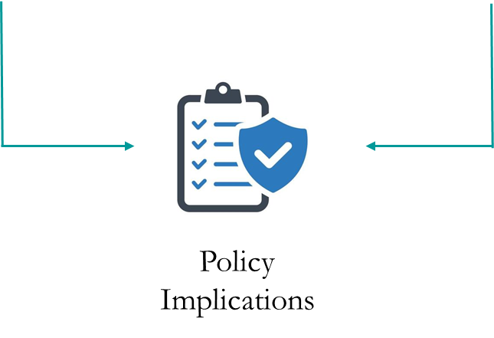
Study Design
Cluster Analysis
ARM Model
ARM Synthesis
CCA
Synthesis
Notes:
This slide represents the study design. First the Ohio crash data was collected from 2017 to 2021. It was then filtered for U-turn crash. After Data cleaning and preprocessing it is ready for analysis. The data was first analyzed by ARM. Thresholds were set and key rules were extracted and visualization of rules for each KA, BC and O. Next CCA was applied to identify the crash patterns and explore the relationships between the attributes. Finally, the key findings from both models were combined for policy implications.

Slide 27
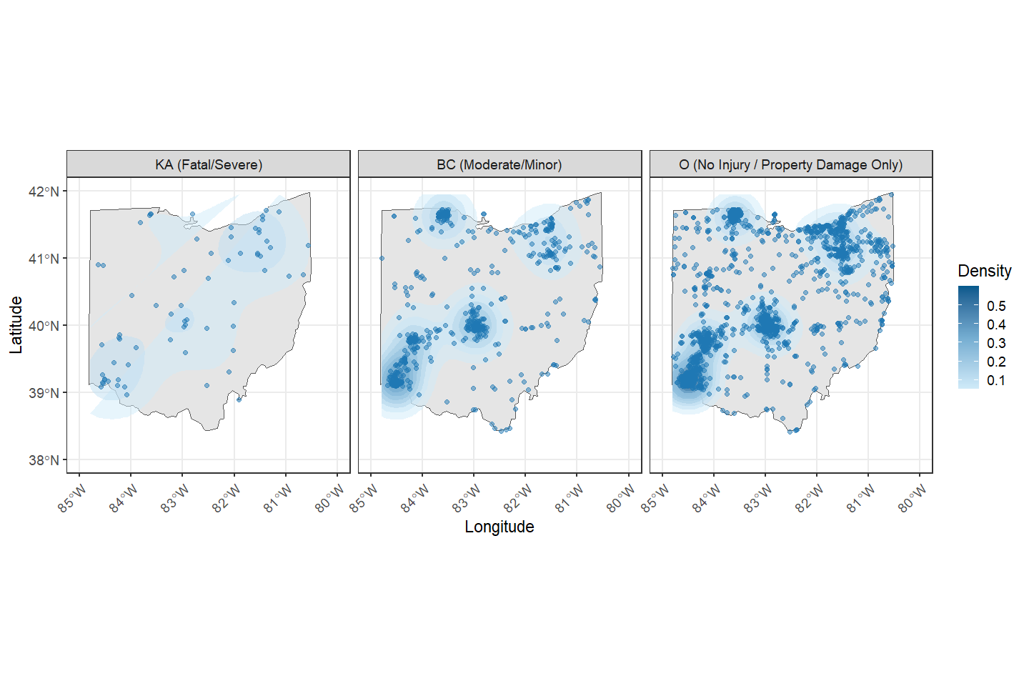


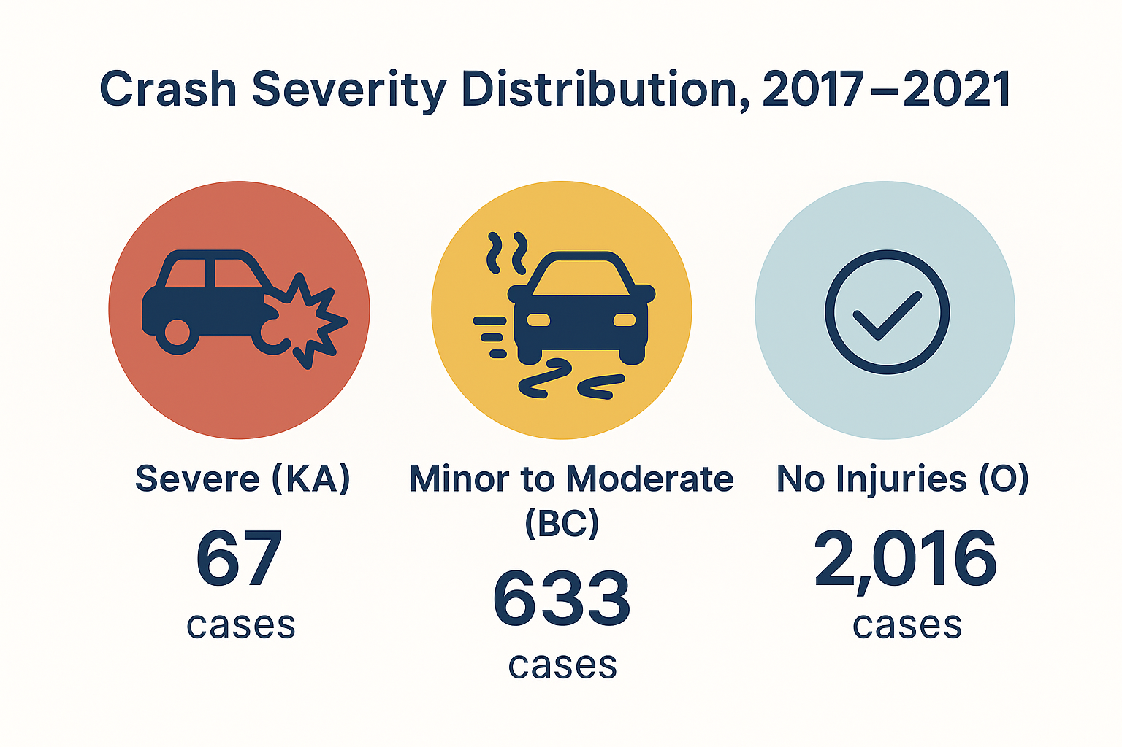
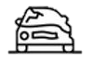
Density Map
KA (Fatal/Sever)
BC
(Moderate/Minor)
O
(No Injury/Properly Damage)
67 Cases
633 Cases
2016 Cases
Notes:
This slide shows the spatial distribution of U-turn crashes across Ohio by severity.
The first map shows fatal or severe crashes (KA), which are relatively scattered across the state. The second map highlights moderate or minor injury crashes (BC), with denser clustering in certain urban areas.
The third map displays property damage only crashes (O), which are widespread—especially in northeastern and central Ohio.

Slide 28
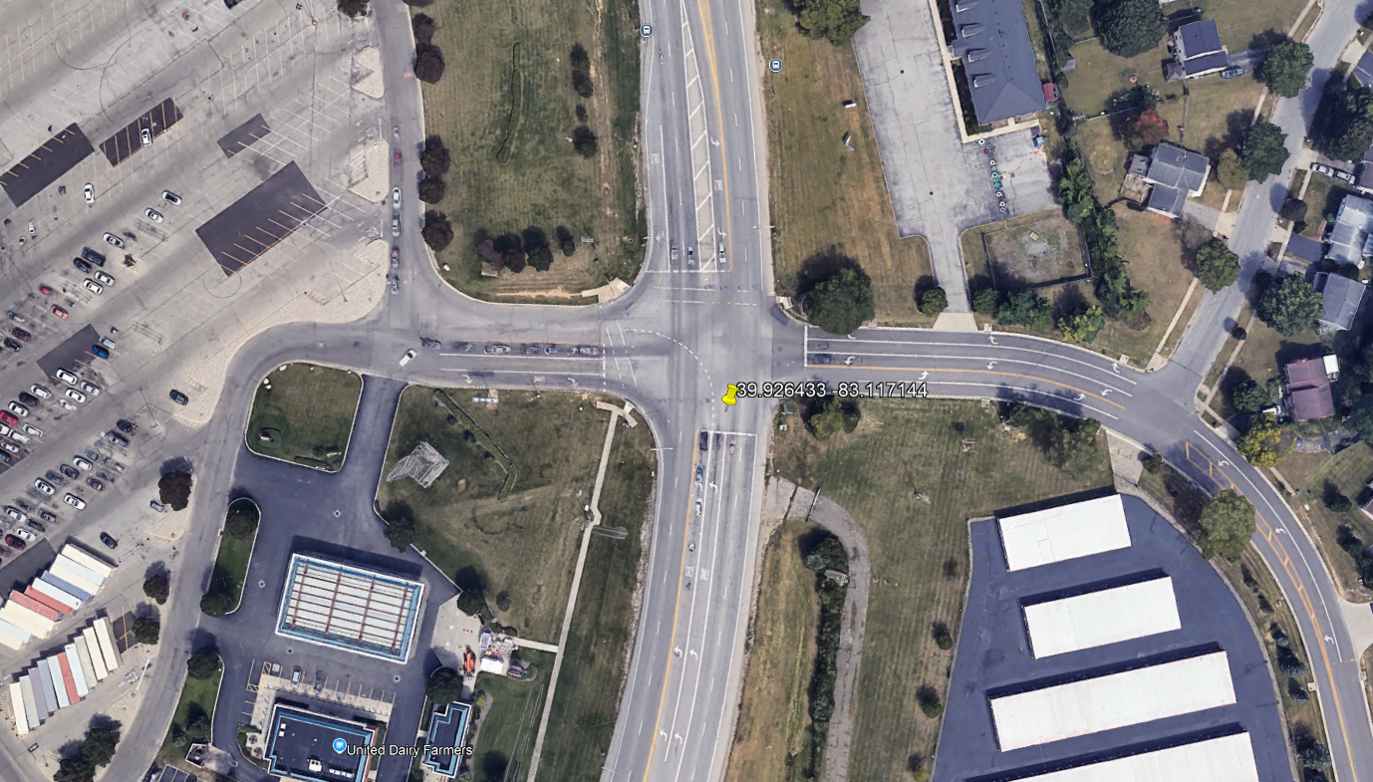
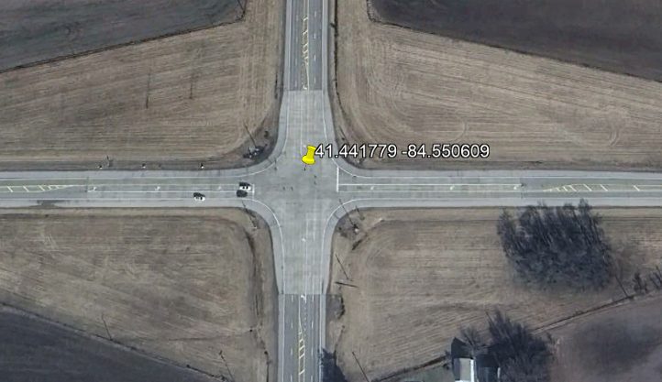
Crash Locations
39°55'35.2"N 83°07'01.7"W
41°26'30.4"N 84°33'02.2"W
Urban Area
Rural Area
Notes:
This is the sample crash location sites. Here, we see that in both urban and rural area both have U-turn crash.

Slide 29
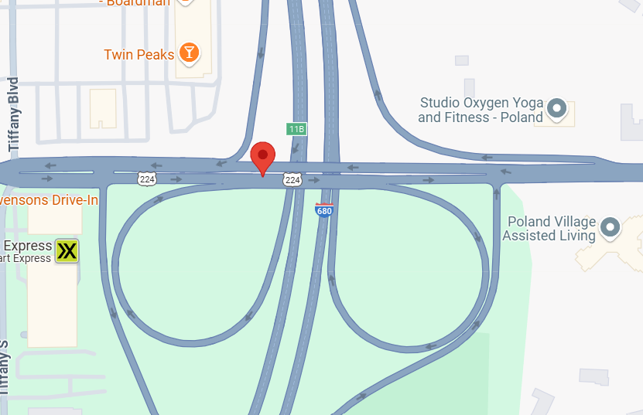
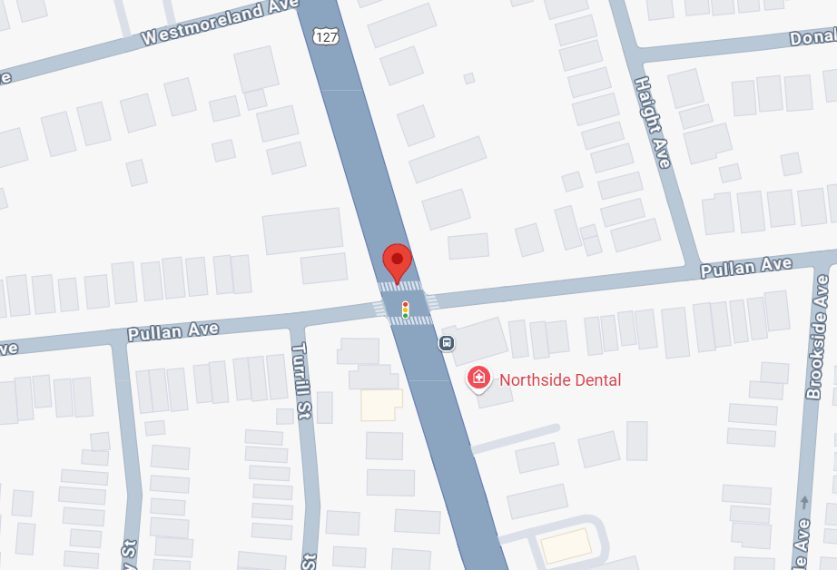
Crash Locations
Complex Intersection
Signalized
Intersection
Notes:
We can also see that U-turn crashes occur at both complex and signalized intersections.

Slide 30
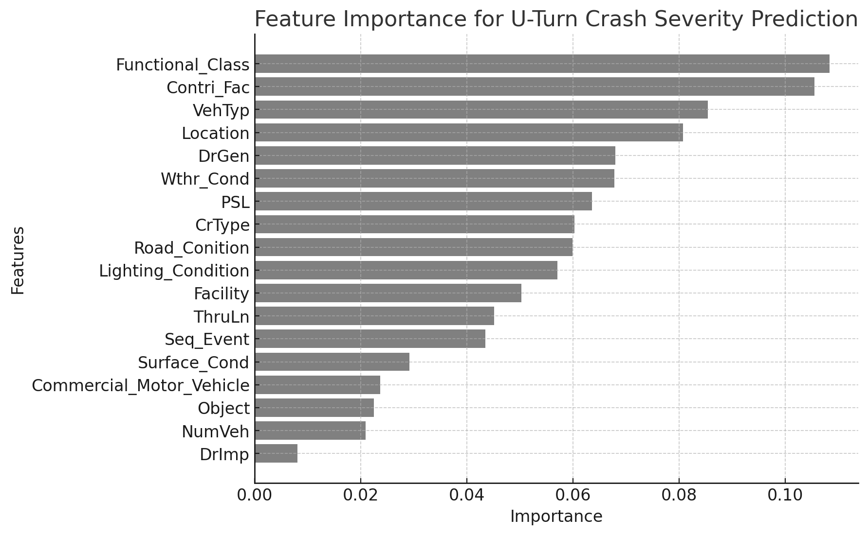
Variable Importance Analysis
Notes:
This chart shows the top factors influencing U-turn crash severity. Key elements include the functional class of the road, contributing factors, vehicle type, and location. Other important factors include driver gender and weather and lighting conditions.

Slide 31
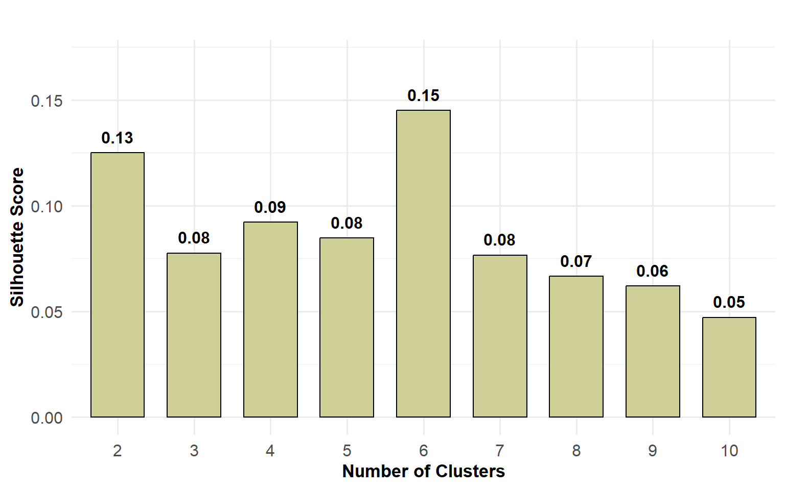
Silhouette Score
Notes:
This bar chart shows the silhouette scores for different cluster counts used in CCA. The highest silhouette score was observed for 6 clusters, suggesting that this number provides the best balance of separation and cohesion in the data. So, a 6-cluster solution was chosen for further crash pattern analysis.

Slide 32
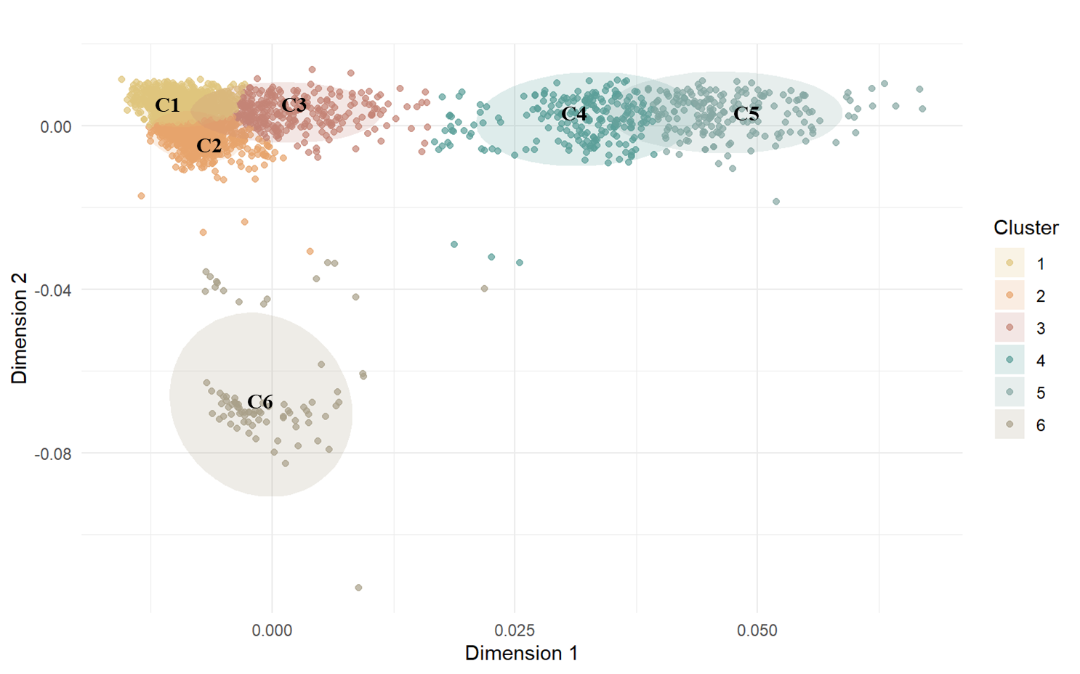
CCA Biplot
Notes:
This biplot shows the six clusters identified through Correspondence Analysis. Each point represents a crash case, and the clusters—C1 through C6—highlight different patterns based on similar crash features.

Slide 33
Centroids and Size of the Clusters
Cluster | U-turn crashes
 | Dim 1 | Dim 2 | Within cluster sum of squares | Size
Cluster 1 | -0.0094 | 0.0050 | 0.0128 | 1182
Cluster 2 | -0.0076 | -0.0029 | 0.0123 | 747
Cluster 3 | 0.0022 | 0.0032 | 0.0099 | 287
Cluster 4 | 0.0314 | 0.0010 | 0.0156 | 223
Cluster 5 | 0.0474 | 0.0030 | 0.0110 | 194
Cluster 6 | -0.0004 | -0.0651 | 0.0176 | 83
Notes:
This table shows the coordinates for each cluster. Cluster 1 is the largest group with 1,182 cases and Cluster 6 is the smallest group consist of 83 cases.

Slide 34
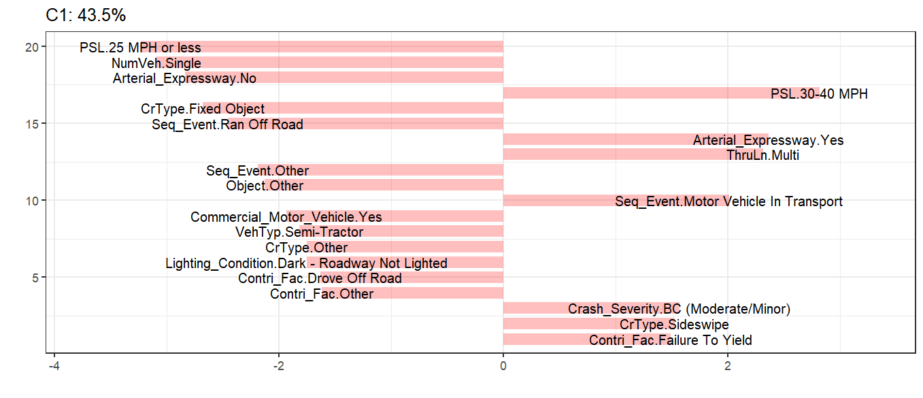
Top Contributing Factors in Cluster C1
Notes:
Cluster C1 accounts for 43.5% of U-turn crash cases. These are typically moderate severity (BC), occurring on arterial roads with 30–40 MPH speed limits. Other variables like multi-vehicle, failure to yield and sideswipe collisions are key contributing factors.

Slide 35
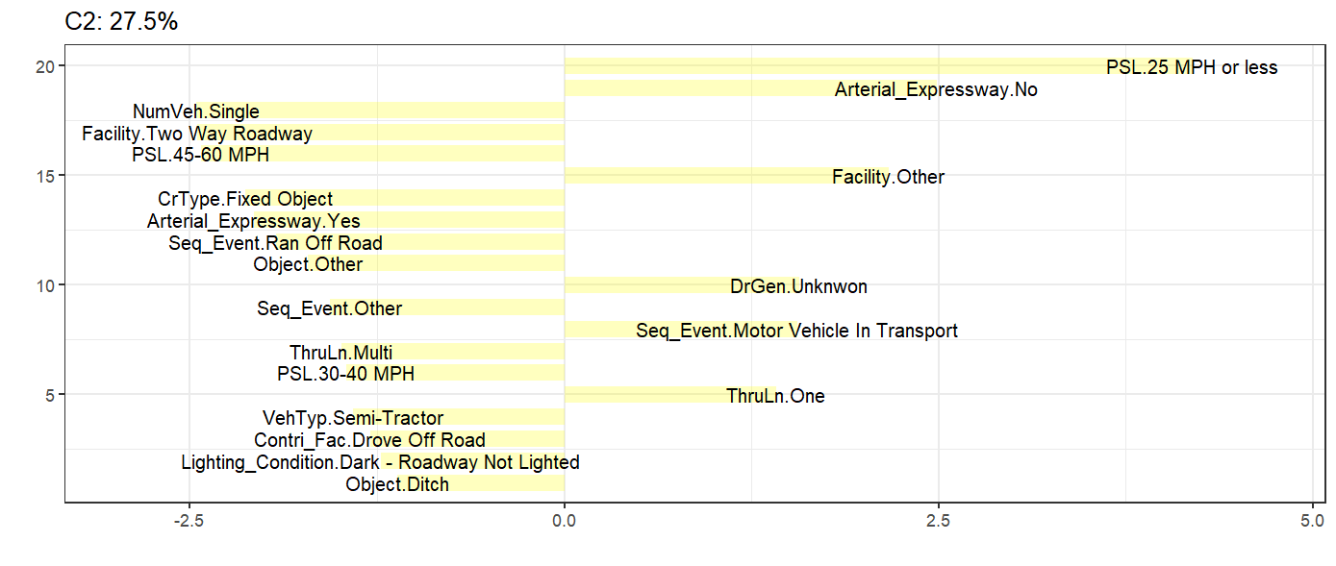
Top Contributing Factors in Cluster C2
Notes:
Cluster C2 represents around 27.5% of the cases and is associated with low-speed zones on non-expressway roads. Other contributing factors are Driver gender, sequential motor vehicle in transportation and thru lane.

Slide 36
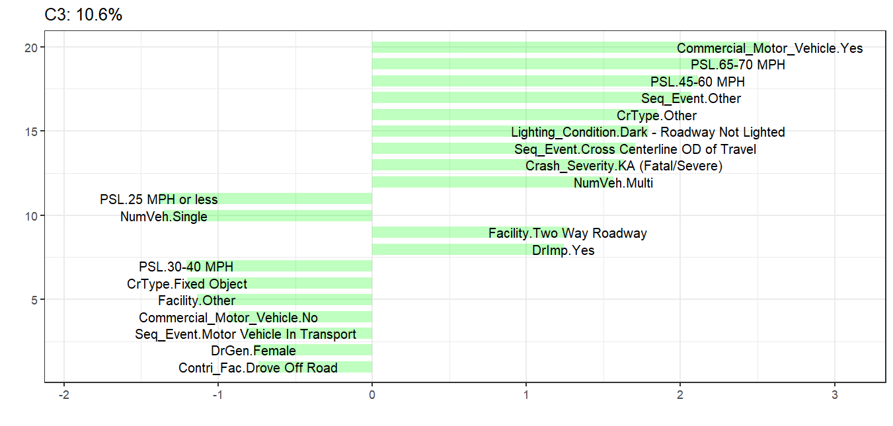
Top Contributing Factors in Cluster C3
Notes:
Cluster C3, reflects 10.6% of the crashes, is dominated by high-speed conditions (65–70 MPH) and involvement of commercial motor vehicles and is associated with KA severity. Other key attributes include dark, unlit areas, driver impairment, and two-way roadways.

Slide 37
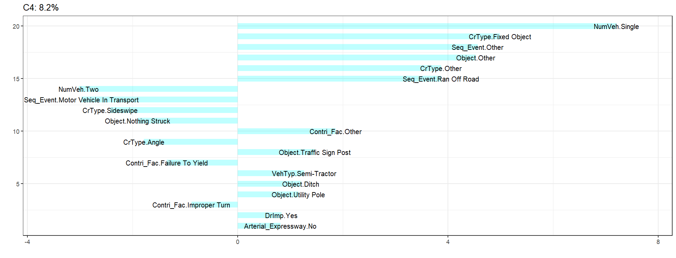
Top Contributing Factors in Cluster C4
Notes:
Cluster C4, contains 8.2% of crashes and, is characterized by single-vehicle and fixed objects. These crashes are linked to Semi tractor, traffic sign post and driver impairment.

Slide 38
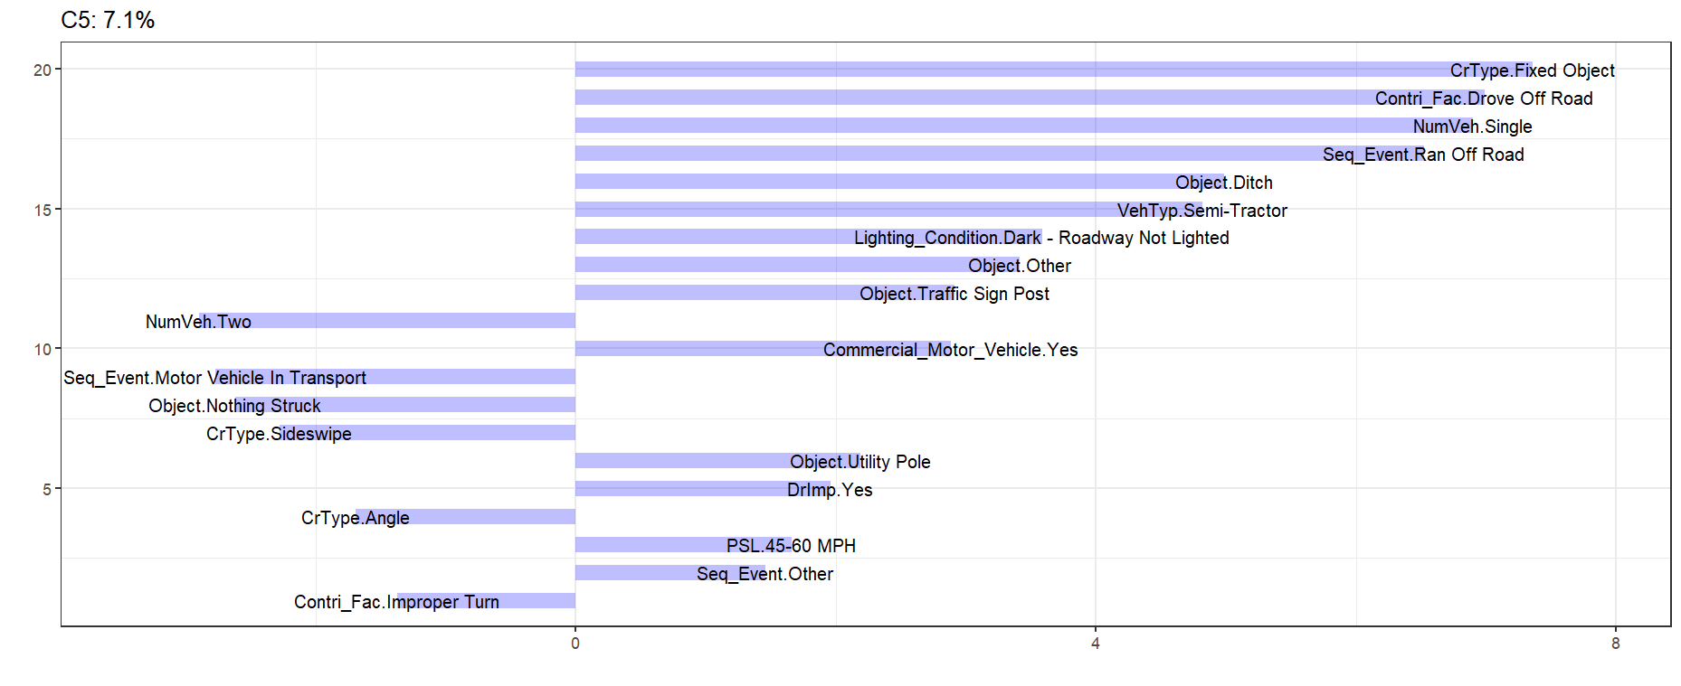
Top Contributing Factors in Cluster C5
Notes:
Cluster C5 contains 7.1% of cases. Features like fixed object, drove off road and single vehicle are the main factors for this cluster.

Slide 39
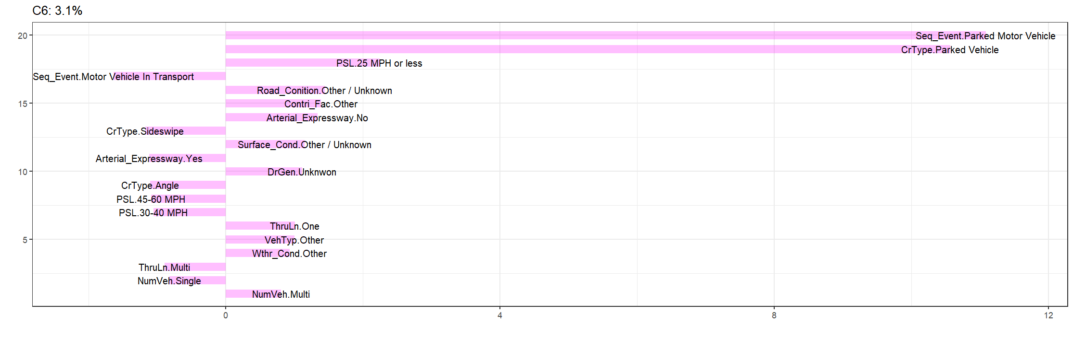
Top Contributing Factors in Cluster C6
Notes:
Cluster C6 contains 3.1% and low-speed and parked vehicles are main variables.

Slide 40
Summary of Cluster Characteristics
Cluster | Right side variables | Detailed Cluster Interpretation
C1 | 7 | U-turn crashes in this cluster mostly occur on moderate-speed roads (30–40 MPH), featuring multiple through lanes and arterial expressways with active vehicle movement.
C2 | 6 | Crashes in this cluster typically take place in simple, low-speed (≤25 MPH) roadway settings with single lanes and absence of arterial features.
C3 | 11 | This cluster is marked by U-turn crashes in high-speed (45–70 MPH) zones under dark and unlit conditions, often involving multiple vehicles and severe outcomes.
C4 | 13 | This Cluster reflects crashes involving single vehicles that lose control and collide with fixed or undefined roadside objects, commonly influenced by driver impairment and road departure behaviors.
C5 | 14 | Crashes here are driven by commercial motor vehicles running off the road and striking roadside hazards such as ditches and signs, with environmental factors like dark, unlit roads and limited traffic playing a role.
C6 | 12 | This cluster involves low-speed crashes often caused by failed U-turn maneuvers near parked vehicles in constrained environments with single lanes.
Notes:
This is the summary table of the 6 clusters.
C1: U-turn crashes mostly occur on moderate-speed roads (30–40 MPH), featuring multiple through lanes and arterial expressways with active vehicle movement.
C2: Crashes occurs in low-speed (≤25 MPH) roadway settings with single lanes and absence of arterial features.
C3: U-turn crashes in high-speed (45–70 MPH) zones under dark and unlit conditions, often involving multiple vehicles and severe outcomes.
C4: Crashes involving single vehicles that lose control and collide with fixed or undefined roadside objects, commonly influenced by driver impairment and road departure behaviors.
C5: Crashes occurs by commercial motor vehicles running off the road and striking roadside hazards such as ditches and signs, with environmental factors like dark, unlit roads and limited traffic playing a role.
C6: Low-speed crashes often caused by failed U-turn maneuvers near parked vehicles in constrained environments with single lanes.

Slide 41
Frequent Crash Patterns by Severity Level
Association Rules with Consequent KA (Fatal/Severe)
Itemset | Antecedent | S | C | L | LIC
2itemset | {Commercial_Motor_Vehicle=Yes} | 0.006 | 0.05 | 1.94 | NA
3itemset | {Commercial_Motor_Vehicle=Yes, DrGen=Female} | 0.002 | 0.12 | 4.96 | 2.56
4itemset | {Commercial_Motor_Vehicle=Yes, DrGen=Female, Functional_Class=Interstate Route} | 0.001 | 0.38 | 15.20 | 3.06
3itemset | {Commercial_Motor_Vehicle=Yes, VehTyp=Passenger Car} | 0.003 | 0.12 | 4.89 | 2.53
4itemset | {Commercial_Motor_Vehicle=Yes, VehTyp=Passenger Car, Functional_Class=Interstate Route} | 0.001 | 0.33 | 13.51 | 2.76
2itemset | {Lighting_Condition=Dark - Roadway Not Lighted} | 0.003 | 0.04 | 1.58 | NA
3itemset | {Lighting_Condition=Dark - Roadway Not Lighted, Location=Four-Way Intersection} | 0.001 | 0.13 | 5.07 | 3.20
4itemset | {Lighting_Condition=Dark - Roadway Not Lighted, Location=Four-Way Intersection, CrType=Angle} | 0.001 | 0.50 | 20.27 | 4.00
Notes:
This slide shows example association rules where KA is the consequent. This is the 2-itemset rule where Commercial_Motor_Vehicle is the antecedent and KA is the consequent, with a lift value of 1.94. Now, when another variable is added to this rule, it becomes a 3-itemset rule. In this case, Driver_Gender Female is added, and the lift becomes 4.96, with an LIC of 2.56. This means that when driver gender is added with commercial motor vehicle, the likelihood of KA increases compared to the 2-itemset.
Similarly, when another variable is added, it becomes a 4-itemset rule. In this case, Functional_Class Interstate Route is added, and the lift becomes 15.2, with an LIC of 3.06. That means when interstate route is added, the likelihood of KA increases compared to the 3-itemset rule.
Similar rules are shown for Passenger_Car and Functional_Class Interstate Route, when added as 3-itemset and 4-itemset rules.
Also, rules are presented for Lighting_Condition Dark, Not Lighted as a 2-itemset, and the corresponding 3-itemset and 4-itemset rules.

Slide 42
Frequent Crash Patterns by Severity Level
Association Rules with Consequent BC (Moderate/Minor)
Itemset | Antecedent | S | C | L | LIC
2itemset | {CrType=Sideswipe} | 0.134 | 0.27 | 1.14 | NA
3itemset | {CrType=Sideswipe, VehTyp=Semi-Tractor} | 0.003 | 0.33 | 1.43 | 1.26
4itemset | {CrType=Sideswipe, VehTyp=Semi-Tractor, PSL=30-40 MPH} | 0.001 | 1.00 | 4.29 | 3.00
2itemset | {PSL=45-60 MPH} | 0.072 | 0.27 | 1.14 | NA
3itemset | {PSL=45-60 MPH, Lighting_Condition=Dark - Lighted Roadway} | 0.008 | 0.33 | 1.41 | 1.24
4itemset | {PSL=45-60 MPH, Lighting_Condition=Dark - Lighted Roadway, NumVeh=Multi} | 0.001 | 0.75 | 3.22 | 2.28
4itemset | {PSL=45-60 MPH, Lighting_Condition=Dark - Lighted Roadway, Location=T-Intersection} | 0.002 | 0.63 | 2.68 | 1.90
4itemset | {PSL=45-60 MPH, Lighting_Condition=Dark – Lighted Roadway, Contri_Fac=Improper Lane Change} | 0.001 | 0.60 | 2.57 | 1.83
Notes:
Similarly, this slide represents the example association rules with the consequent BC. The first 2-itemset rule involves Crash_Type Sideswipe, followed by its corresponding 3-itemset and 4-itemset rules. And these are the rules for PSL 45-60 MPH when act as 2itemset rules.

Slide 43
Frequent Crash Patterns by Severity Level
Association Rules with Consequent O (No Injury)
Itemset | Antecedent | S | C | L | LIC
2itemset | {Lighting_Condition=Dark - Roadway Not Lighted} | 0.067 | 0.79 | 1.06 | NA
3itemset | {Lighting_Condition=Dark - Roadway Not Lighted, Surface_Cond=Wet} | 0.019 | 0.87 | 1.17 | 1.1
4itemset | {Lighting_Condition=Dark - Roadway Not Lighted, Surface_Cond=Wet, DrImp=Yes} | 0.002 | 1.00 | 1.35 | 1.15
4itemset | {Lighting_Condition=Dark - Roadway Not Lighted, Surface_Cond=Wet, PSL=65-70 MPH} | 0.002 | 1.00 | 1.35 | 1.15
2itemset | {Wthr_Cond=Cloudy} | 0.179 | 0.76 | 1.02 | NA
3itemset | {Wthr_Cond=Cloudy, PSL=25 MPH or less} | 0.058 | 0.83 | 1.12 | 1.1
4itemset | {Wthr_Cond=Cloudy, PSL=25 MPH or less, Lighting_Condition=Dark - Roadway Not Lighted} | 0.003 | 1.00 | 1.35 | 1.2
4itemset | {Wthr_Cond=Cloudy, PSL=25 MPH or less, Object_ Struck =Traffic Sign Post} | 0.001 | 1.00 | 1.35 | 1.2
Notes:
Similarly, these are example association rules with the consequent O. The first 2-itemset rule involves Lighting_Condition Dark - Roadway Not Lighted, followed by its corresponding 3-itemset and 4-itemset rules. This is the 2-itemset rule for Wthr_Cond Cloudy, along with its related 3-itemset and 4-itemset rules.

Slide 44
Frequent Crash Patterns by Severity Level
Visualization of KA Rules
Lighting: Dark Roadway
Commercial Motor Vehicle
Semi-Tractor Involvement
Posted Speed Limit (65–70 MPH)
Multi-Vehicle Crash
Vehicle Type
Four-Way Intersection
LIC = 3.20
Four-Way Intersection
LIC = 7.91
Motor Vehicle in Transport
LIC = 4.64
Four-Way Intersection
LIC = 2.91
Improper Turn
LIC = 1.65
Driver Gender = Female LIC = 2.56
Passenger Car
LIC = 2.53
Commercial Vehicle
LIC = 7.07
Improper Turn
LIC = 2.00
Commercial Vehicle
LIC = 2.13
Crash and Roadway Features
Demographic Factors
Crash Type = Angle
LIC = 4.00
Commercial Vehicle
LIC = 10.00
Interstate Route
LIC = 3.06
Interstate Route
LIC = 2.76
Other Event
LIC = 2.55
Notes:
This slide represents the visualization of the top selected rules with KA as the consequent.

Slide 45
Frequent Crash Patterns by Severity Level
Visualization of BC Rules
Failure to Yield
Sport Utility Vehicle
Improper Turn
Posted Speed Limit (45–60 MPH)
Sideswipe Crash
Driver Gender = Male LIC = 1.09
T-Intersection
LIC = 1.32
Lighting Condition = Dark – Lighted Roadway, LIC = 1.37
Lighting Condition = Dark – Lighted Roadway, LIC = 1.24
Vehicle Type Demographic Factors
Semi-Tractor LIC = 1.26
Crash and Roadway Features
Road Condition = Curve Level, LIC = 3.04
Thru Lane = One
LIC = 3.04
Lighting Condition = Dawn/Dusk, LIC = 1.74
Environmental Factors
Multi-Vehicle
LIC = 2.28
T-Intersection
LIC = 1.90
Improper Lane Change
LIC = 1.83
Surface Condition = Snow LIC = 2.18
Improper Lane Change LIC = 2.07
Posted Speed Limit = 30–40 MPH , LIC = 3.00
Weather = Cloudy LIC = 1.50
Notes:
This slide represents the visualization of the top selected rules with BC as the consequent.

Slide 46
Frequent Crash Patterns by Severity Level
Visualization of O Rules
Low Speed Zone (≤25 MPH)
Cloudy Weather
Dark, Unlighted Roadway
Parked Vehicle Crash
Drove Off Road
LIC = 1.08
Surface Condition = Wet LIC = 1.10
Single Vehicle LIC = 1.06
Speed Limit ≤ 25 MPH LIC = 1.10
Vehicle Type Driver Condition
Functional Class = Interstate Route, LIC = 1.08
Lighting Condition = Dawn/Dusk, LIC = 1.08
Surface Condition = Wet, LIC = 1.08
Crash and Roadway Features
Lighting Condition = Dark – Not Lighted, LIC = 1.16
Driver Impairment = Yes, LIC = 1.15
Speed Limit = 65–70 MPH, LIC = 1.15
Object Struck = Traffic Sign Post, LIC = 1.15
Semi-Tractor LIC = 1.16
Lighting = Dark – Not Lighted, LIC = 1.20
Weather = Snow LIC = 1.17
Road Condition = Curve Grade, LIC = 1.15
Functional Class = Interstate Route, LIC = 1.17
Environmental Factors
Notes:
This slide represents the visualization of the top selected rules with O as the consequent.

Slide 47
Narrative-Based Summary
Severity Level | Road Context / Location | Fault Summary | U-Turn Behavior | Vehicle Interaction | Narrative Summary
O | Residential street | Loss of control on snow | Sudden U-turn | Rear-end by Unit 2 | Unit 1 spun out and did a U-turn in front of Unit 2; collision occurred due to lack of stopping time.
BC | Urban two-lane road | Improper U-turn | U-turn into same lane | Struck by Unit 2 | Unit 1 attempted U-turn and was hit by Unit 2 in same travel lane.
KA | Little York Rd | Loss of control | U-turn before ditch | Off-road crash | Unit 1 lost control during U-turn and ended up in ditch.
Notes:
Crash narrative-based analysis was also conducted. For example, in the first case, the U-turn crash occurred due to a lack of stopping time and resulted in property damage. In the second case, Unit 1 attempted a U-turn and was struck by Unit 2, leading to moderate injury. In the final case, the crash occurred due to loss of control during the U-turn, ending in a ditch and resulting in a fatal or major injury.

Slide 48
Multimodel Comparison
Severity | ARM-LIC | CCA | Key Insights
KA | Multi-vehicle, high speed (65–70 mph), CMVs, dark roads, improper turns | C3 & C5: High speed, CMV, dark roads, driver impairment | Both models link severity to speed, lighting, heavy vehicles; CCA adds impairment
BC | Sideswipes, SUVs, improper turns, 45–60 mph zones | C1 (arterial) & C2 (non-arterial): Moderate-speed crashes | Both show maneuver complexity; ARM gives crash types, CCA highlights road types
O | Parked vehicles, <25 mph, dark/wet roads | C6: Low-speed, urban, parked vehicle crashes | Both agree low-speed & simple contexts reduce injury; ARM notes surface & lighting
Notes:
This table presents a comparison between the findings of the two models. For KA crashes, both models indicate that high speed, poor lighting, and involvement of heavy vehicles are significant contributing factors. In the case of BC crashes, both models show maneuver complexity; however, the ARM model emphasizes crash types, whereas the CCA model focuses on road types. For O severity crashes, both models find that low-speed environments are associated with reduced severity, while ARM model prioritize also the dark and wet road conditions.

Slide 49
Conclusion
ARM-LIC revealed that certain combinations of factors—such as improper turning behavior, commercial vehicles, and high-speed zones—frequently co-occurred in severe U-turn crashes.
The LIC showed how layering additional context (e.g., poor lighting or intersection type) can strengthen the link between risk factors and crash severity.
CCA showed that U-turn crashes follow distinct patterns shaped by either environmental conditions (e.g., darkness, wet roads) or driver factors (e.g., failure to yield), highlighting the context-specific nature of crash risks.
Notes:
Now the conclusion part of the study.
ARM-LIC revealed that improper turning behavior, commercial vehicles, and high-speed zones frequently co-occurred in severe U-turn crashes.
The Lift Increase Criterion showed how layering additional context can strengthen the link between risk factors and crash severity.
CCA showed that U-turn crashes follow distinct patterns shaped by either environmental conditions (e.g., darkness, wet roads) or driver factors (e.g., failure to yield), highlighting the context-specific nature of crash risks.

Slide 50
Conclusion
CCA plots further illustrated that crashes with the same setting—such as night-time rural segments (C3) or busy urban arterials (C1)—naturally cluster together, highlighting sharp differences in risk profiles across locations.
The combined findings emphasize the need for infrastructure upgrades, speed zone adjustments, and targeted driver education in high-risk U-turn scenarios to address the diverse factors contributing to crash severity.
Notes:
CCA plots further illustrated that crashes with the same setting—such as night-time rural segments or busy urban arterials—naturally cluster together.
The combined findings emphasize the need for infrastructure upgrades, speed zone adjustments, and targeted driver education in high-risk U-turn scenarios to address the diverse factors contributing to crash severity.

Slide 51
Limitations
The analysis relies on crash data from a single state, which may limit the generalizability of the findings to areas with different roadway designs, enforcement standards, or driver behavior patterns.
The use of historical crash records prevents the study from capturing real-time conditions such as driver distraction, vehicle malfunction, or instantaneous traffic flow, which could influence crash severity but are often unreported.
Alternative intersections (e.g., MUTs and RCUTs) reroute left-turns and change conflict point patterns, often resulting in different crash behaviors compared to conventional intersections. However, this analysis could not distinguish between these designs, making it difficult to capture how their unique configurations might influence U-turn crash severity.
Notes:
The limitations of this study are-
The analysis relies on crash data from a single state, which may limit the generalizability of the findings to areas with different roadway designs, enforcement standards, or driver behavior patterns.
The use of historical crash records prevents the study from capturing real-time conditions such as driver distraction, vehicle malfunction, or instantaneous traffic flow.
Alternative layouts (e.g., MUTs and RCUTs) reroute left-turns and change conflict point patterns, often resulting in different crash behaviors compared to conventional intersections. However, this analysis could not distinguish between these designs, making it difficult to capture how their unique configurations might influence U-turn crash severity.

Slide 52
Future Research
Incorporate multi-state and real-time data to better capture dynamic crash factors and improve generalizability.
Investigate the impact of innovative intersections like MUTs and RCUTs on U-turn safety, as their unique geometry may lead to different crash trends than traditional designs.
Investigate the role of vehicle automation features (e.g., lane-keeping, collision warning) in U-turn crashes to assess how AV technologies may alter risk patterns.
Notes:
So future research can be done to-
Incorporate multi-state and real-time data to better capture dynamic crash factors and improve generalizability.
Investigate the impact of innovative intersections like MUTs and RCUTs on U-turn safety.
Investigate the role of vehicle automation features (e.g., lane-keeping, collision warning) in U-turn crashes to assess how AV technologies may alter risk patterns.

Slide 53
Publications on Thesis
Paper 1
Uncovering Robust Patterns in U-Turn Crash Severity Using Lift Increase Criterion in Association Rule Mining Using Multimodal Data.
Submitted to: Journal of Transportation Safety & Security (JTSS)
Paper 2
Pattern Recognition and Risk Analysis in U-Turn Crashes.
Under review at: Transportation Research Record (TRR)
Paper 3
Revisiting U-Turn Configurations: A Systematic Review of Design Innovations and Safety Implications.
Under review at: Transportation Research Record (TRR)

Slide 54
References
Agrawal, R., Imieliński, T., Swami, A., 1993. Mining association rules between sets of items in large databases. SIGMOD Rec. 22, 207–216. https://doi.org/10.1145/170036.170072
Agrawal, R., Srikant, R., 1994. Fast Algorithms for Mining Association Rules in Large Databases, in: Proceedings of the 20th International Conference on Very Large Data Bases, VLDB ’94. Morgan Kaufmann Publishers Inc., San Francisco, CA, USA, pp. 487–499.
Brin, M.F., 1997. Botulinum toxin: Chemistry, pharmacology, toxicity, and immunology. Muscle & Nerve 20, 146–168. https://doi.org/10.1002/(SICI)1097-4598(1997)6+<146::AID-MUS10>3.0.CO;2-4
Fan, H.Q., Jia, B., Li, X.G., Tian, J.F., & Yan, X.D., 2013. Characteristics of traffic flow at nonsignalized T-shaped intersection with U-turn movements. The Scientific World Journal.

Slide 55
References
Khan, T., Vivek, A.K. and Mohapatra, S.S., 2021. Comparative appraisal of critical gap estimation techniques in the context of U-turning vehicles. Transportation Research Record, [online] 2675(12). https://doi.org/10.1177/03611981211035761
Liu, P., Wang, X., Lu, J. and Sokolow, G., 2007. Headway acceptance characteristics of U-turning vehicles at unsignalized intersections. Transportation Research Record: Journal of the Transportation Research Board, 2027, pp.52-57. https://doi.org/10.3141/2027-07
Wu, W., Sun, R., Li, Y. and Chen, R., 2020. Cooperative U-turn merging behaviors and their impacts on road traffic in CVIS environment. Journal of Advanced Transportation. https://doi.org/10.1155/2020/4158569
Inman, V. W., Haas, R. P., & Yang, C. Y. D. (2013). "Evaluation of Restricted Crossing U-Turn Intersection as a Safety Treatment on Four-Lane Divided Highway". ITE Journal, 83(9), 29.

Slide 56

THANK YOU!
Syed Aaqib Javed
Graduate Student,
Ingram School of Engineering
Texas State University
Email: jfk28@txstate.edu

